Slide 1
AMIRI HOSPITAL PHARMACY DEPARTMENT
Clinical Pharmacy at
Amiri Hospital
Fatma Al-Qenaie
Sara Al-Khatrash
Afrah Al-Kazemi
20-5-2015

Slide 2
Outline:
Amiri Hospital
Clinical pharmacist
Clinical pharmacy at Amiri Hospital
Scope of service
Future plans
Conclusion

Slide 3
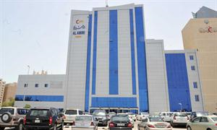
Amiri Hospital

Slide 4
Amiri Hospital
General governmental hospital
17 wards and 418 beds / inpatients :
1 ICU
2 CCU
2 Gastrology wards
2 Nephrology wards
2 Paediatric wards
4 Surgical wards
4 Medical wards

Slide 5
Clinical Pharmacists at Amiri Hospital
Sara Al-Khatrash, MSc CPIPP* (UCL, 2013)
Pharmacist managed diabetic clinic at Khaldiya Polyclinic - I MAP tool
Fatma Al-Qenaie, MSc CPIPP* (UCL, 2014)
Pharmacist managed diabetic clinic at Amiri Hospital
An audit on the clinical appropriateness of prescribing oxygen: benchmarking against BTS guideline
Afrah Al-Kazemi, MSc CPIPP* (UCL, 2014)
(UK Clinical Pharmacy Association Master Class in Cardiology and Sepsis in ICU, 2015)
Critical care clinical pharmacy service in Amiri Hospital
An evaluation of pharmaceutical care provision within the ‘Hospital at Home’ service
* CPIPP: Clinical Pharmacy International Practice and Policy

Slide 6
Clinical Pharmacy at Amiri Hospital
Aim: working within multi-disciplinary team to support managed treatment and patient safety
Objectives:
Review prescription in the ward
On spot intervention
Monitoring drug therapy
Being available - and visible !!!

Slide 7
Clinical Pharmacy at Amiri Hospital – Scope of service
Attend morning rounds
Daily assessment of renal function (CrCl)
Increase ward stock items (daily ward stock)
Vancomycine TDM, ICU (Afrah)
Paediatric drug handbook (Sara)
Antimicrobial guideline and antibiotic handbook (Fatma)
Medical representative meeting with internal medicine doctors (Fatma)

Slide 8
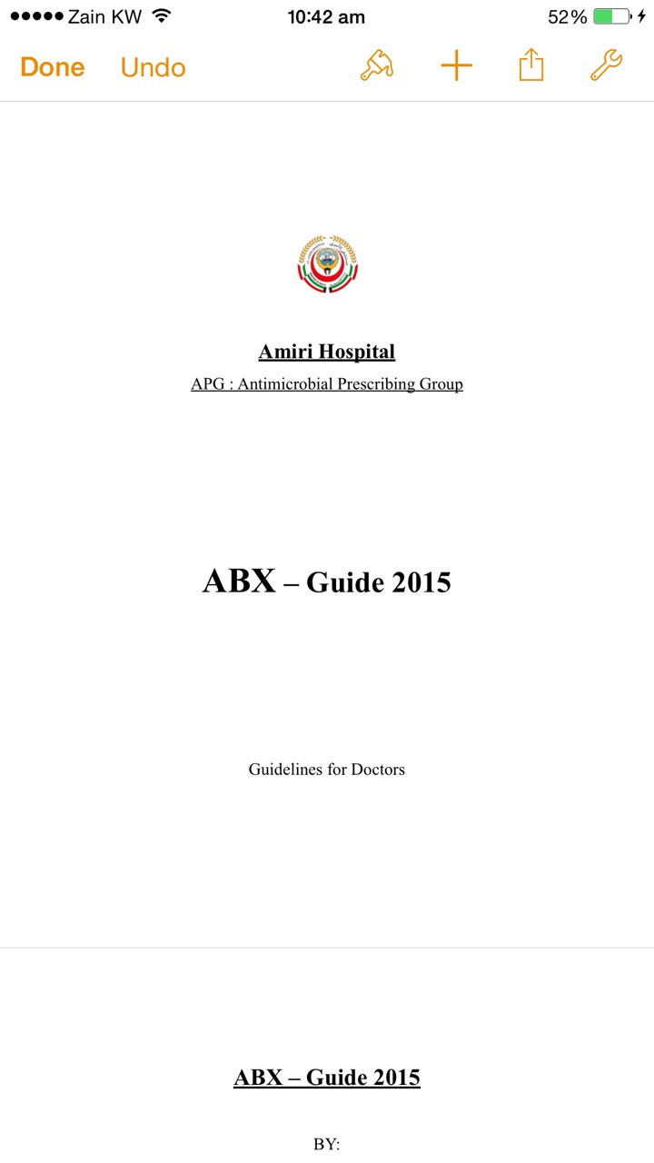

Slide 9
Future plans
Therapeutic drug monitoring
Antimicrobial stewardship programme, Collaboration with microbiology department
Anticoagulation committee

Slide 10
Conclusion
Amiri hospital
Clinical pharmacist
Clinical pharmacy service
Future plans

Slide 11
Thank you for listening
Any questions?

